Slide 1


CRIME RATE ANALYSIS DATABASE SYSTEM
GROUP 3: GAURI PATIL GREESHMA JANPALA SIVANAGENDRA MARADA SWAPNIL PATIL
DMDD 6210

Slide 2


Objectives
01
04
05
03
Provide comprehensive overview of crime
Offer recommendations for improving public safety by collaborating with law enforcement agency
Examine trends in crime
Identify Safer Neighborhood
Investigate factors contributing to crime rate

Slide 3

High Level Design
Data Insertion
Insertion of data depending on historic and demographic data
03
Creating
Table Structure
04
Database Operations
Creation of table structures for all the components of the crime analysis system
02
Creating and Executing of Stored procedures, UDF’s and Triggers relevant to system
Identifying trends
Database Design
05
Based on procedures and views , identify trends about crime rate ,effect of weather and instances of a particular time
Define functional, nonfunctional and factors pertaining to crime to identify entities and relationships
01

Slide 4

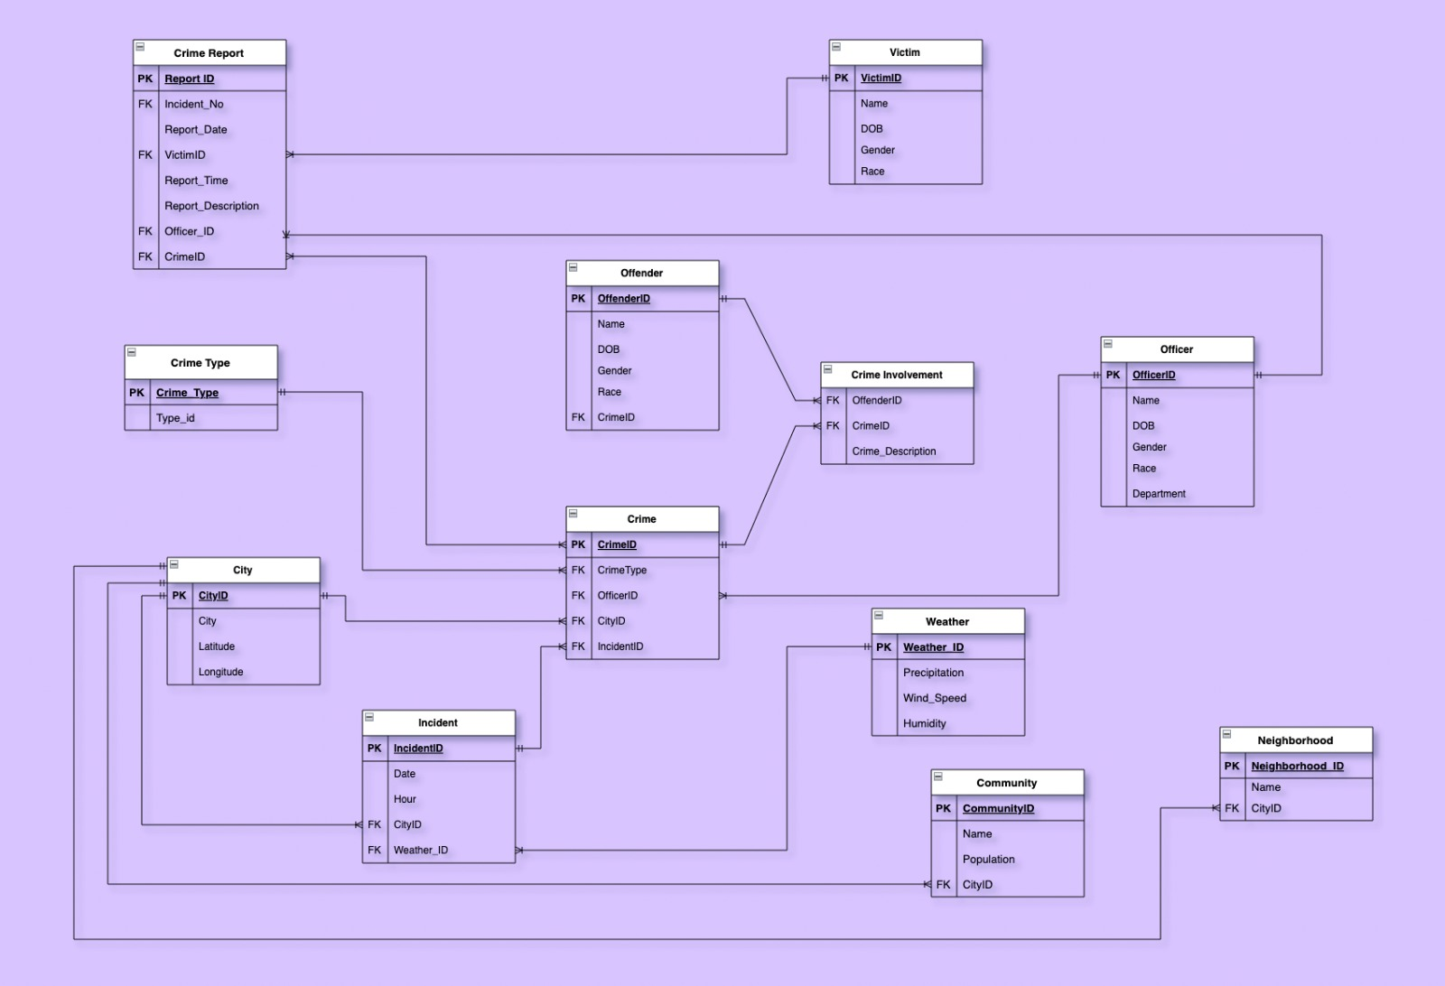
Final ERD

Slide 5

Database Objects
Crime Count by City
Crime Count by Month
Retrieve crimes reported by Officer
Incidents by Date range
Stored Procedures
Crime count by officer
Age calculation from DOB
Report Date should not be before incident
UDF
Objects
To maintain Officer Auditing
To check if crime description is null in crime report.
Triggers
Views
To view Decrypted Crime report
Number of crimes victim is involves in
Crime reported by City
Crimes reported Month wise
Encryption of Crime Description for security reasons
Encryption

Slide 6

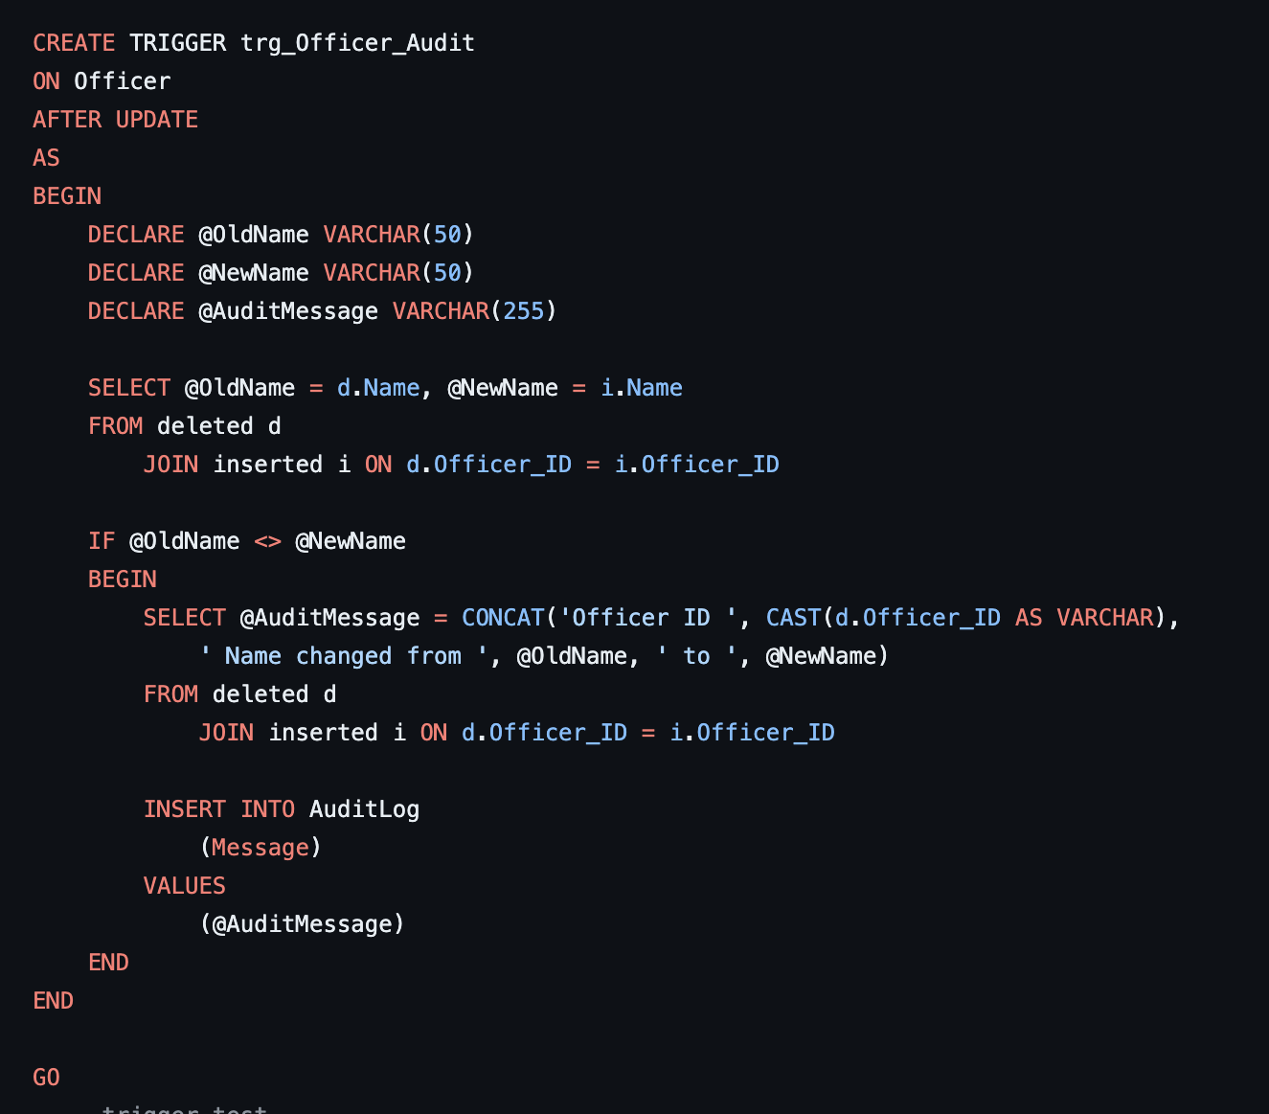
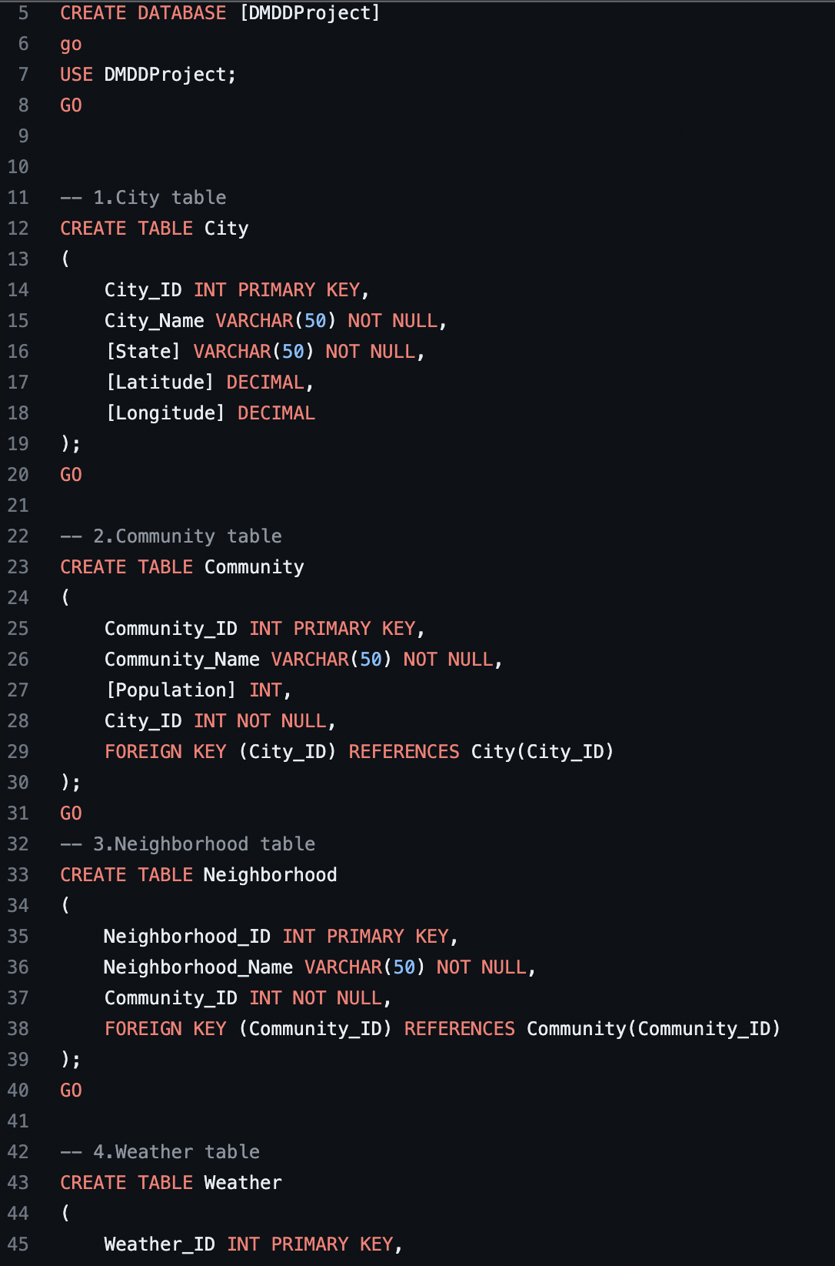
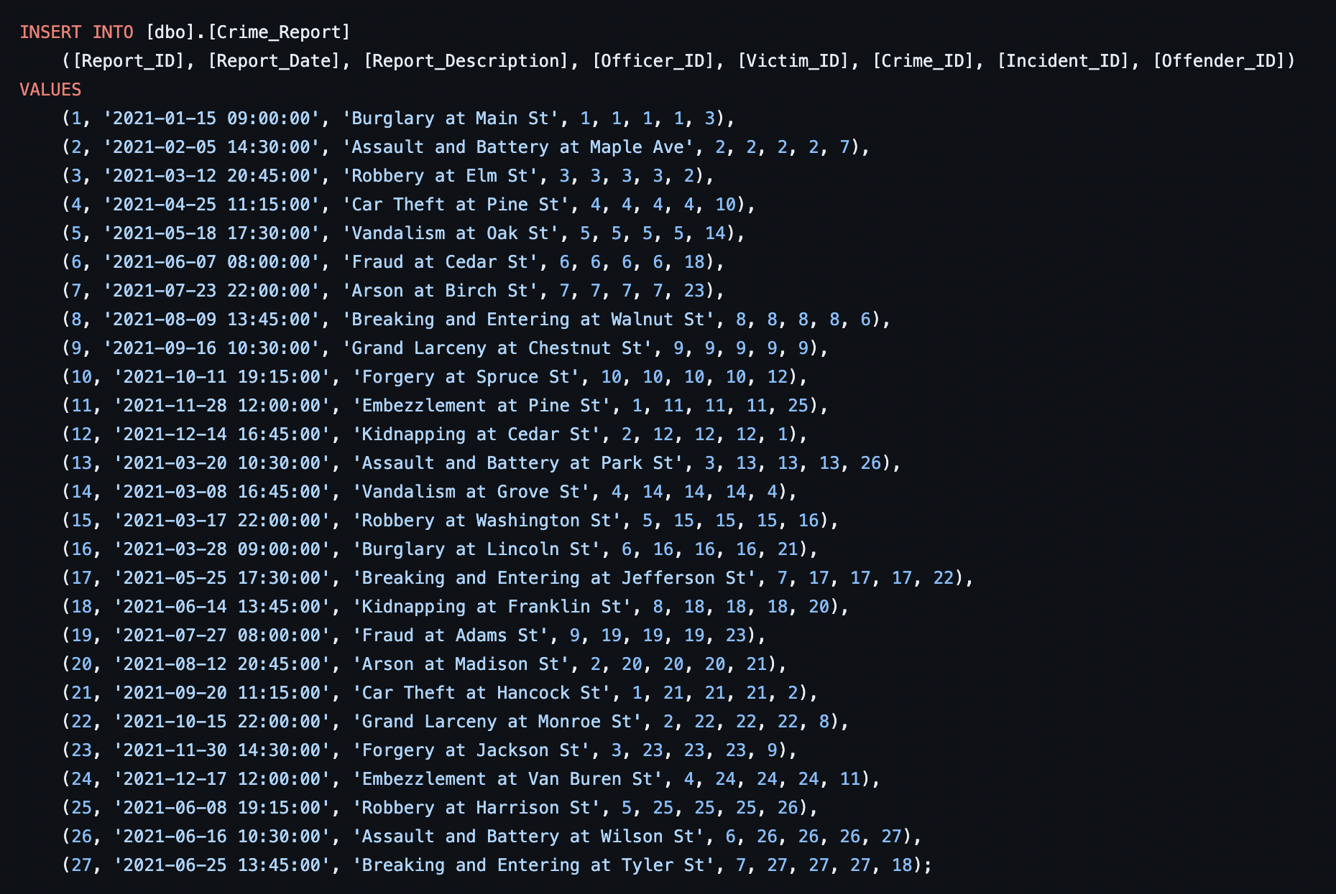
DDL/DML Scripts

Slide 7
LIVE DEMO

Slide 8

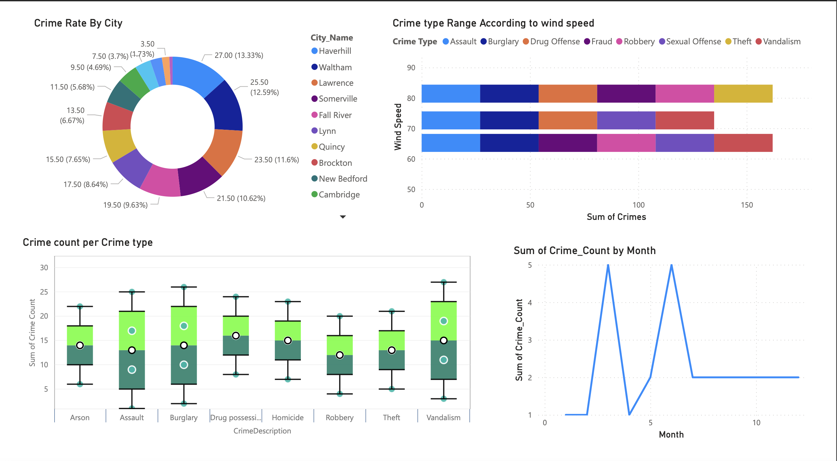
Visualisation (POWER BI)

Slide 9

Future Scope
Outcomes
Improved crime analysis and prevention
Increased efficiency and effectiveness of law enforcement
Better resource allocation
The crime rate analysis database system can be integrated with other systems such as surveillance systems, emergency response systems, and social media monitoring systems
The crime rate analysis database system can be enhanced with predictive analytics capabilities to forecast crime trends
A mobile application to access real-time crime data and analysis on-the-go.
The crime rate analysis database system can be expanded to cover other cities or regions

